Slide 1
Infectious Disease Campaign Advisory Group
Applicant pack

Slide 2
Who we are
Wellcome is a global charitable foundation established in 1936. Through our work we support science to solve the urgent health issues facing everyone.
We fund curiosity-driven research, and we’re taking on three of the biggest health challenges facing humanity – climate change, infectious disease and mental health.
We also work with policy makers, run advocacy campaigns, and form partnerships with other organisations to ensure everyone, everywhere benefits from advances in health science.

Slide 3
Campaigning at Wellcome
We are part of the Public Engagement and Campaigns team within Wellcome’s Corporate Affairs department.
The Wellcome campaign team have previously run successful campaigns such as Reimagine Research and the Covid-19 Access campaign.
Under Wellcome’s new strategy, we are a revised team with a fresh mandate to do more ambitious campaigns on systemic issues.
Notes:
Natalie

Slide 4
About Wellcome’s work on Infectious Disease
The world waits for infectious diseases to escalate before it acts. This increases their risk and impact, disproportionately affecting marginalized communities and those in low resource settings.
Wellcome is working towards the ultimate goal that fewer people suffer the consequences of infectious diseases. That means reducing their risk and impact.
To reduce risk, the world needs to act earlier, before diseases escalate. To reduce impact, action to predict, detect and mitigate infectious diseases must be effective and equitable.
We are funding research to increase the world's understanding of infectious diseases, what makes them escalate and how we can reduce their impact. But this will only work if we also make sure the global community is willing and able to act on this knowledge. That's where campaigning helps.

Slide 5
Our campaign objectives
In the short to medium term, our objectives are to:
Increase awareness of the problems and solutions within the R&D (research and development) ecosystem by highlighting key research or activity that brings the problem home to decision makers and links it to the issues they care about
Make the case for a more effective and equitable R&D ecosystem, with a focus on industry and government buy-in to Wellcome’s vision in the next two to five years
Bring Global North and Global South stakeholders together to identify actions they can take within the wider infectious disease ecosystem to prevent escalating infectious diseases, ensuring communities most affected are centred in the conversation
We will focus on policymakers and industry as the main audiences for the campaign. There are many stakeholders – such as communities most affected and our grantees – that we will also campaign with.

Slide 6
The Advisory Group

Slide 7
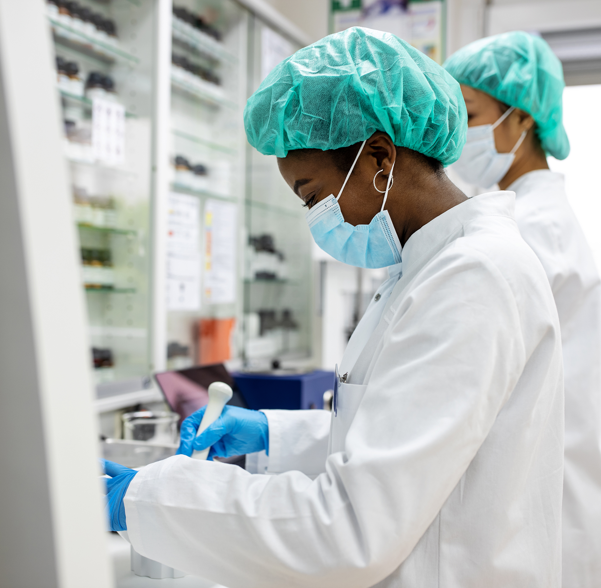
Objectives
To provide expert input on the development of Wellcome’s infectious disease campaign strategy and implementation
To promote inclusivity and equity in Wellcome’s infectious disease campaign approach
To provide global perspectives to help ensure the campaign is suitable and effective for target markets
To check and challenge Wellcome's proposed approach and ideas in a constructive manner

Slide 8
Membership
We are looking for 10 members from across the world with experience successfully campaigning to achieve change in infectious disease.
We are particularly interested to hear from you if you have worked in Brazil, South Africa, India, Indonesia or the US, as these will be key countries we will focus on to build and deliver our campaign.
We encourage applications from candidates who are disabled, neurodivergent, LGBTQIA+, care experienced, stateless, and any community that is typically underrepresented.

Slide 9
Accessibility
We know that we may not get things right, but we believe that accessibility is a necessity, not a luxury. We will hold ourselves to account and make sure that:
We will provide a translator if you prefer to communicate in a language that is not English.
We will enable auto-captioning through Microsoft Teams, the video call platform we use.
The sessions will not be recorded so that we can have a safe space together.
We will follow inclusive meeting guidelines, which our team at Wellcome is piloting to make meetings more inclusive for all.
If you have further access needs or questions, please email us at idcampaign@wellcome.org, and we’ll do all that we can to support you.

Slide 10
How can you support Wellcome’s campaigns?
We want to work with you to deliver impactful, equitable and innovative campaigns in our target countries, informed by your experience.
The feedback and recommendations of the Advisory Group will be used by the Wellcome Campaigns team in their decision making about the infectious disease campaign.
Your knowledge and experience will ensure that our campaigns work well beyond a UK context.
Working together with the rest of the Campaign Advisory Group, your unique perspective will make sure our campaign approach is effective and equitable in a global context.

Slide 11
What we need from you
Wellcome is looking to run long term campaigns (3-5 years+) as we tackle long term and systemic issues, but we understand that members may not be able to commit indefinitely.
We are looking for members that will be able to make a minimum of one year commitment from August 2023 to the group.
The core deliverable will be feedback on the progression of the infectious disease campaign. This would include one day of work per month including:
Attending a monthly meeting with the Wellcome team lasting 1-2 hours
Time to review documents/assets and submit written feedback.
The Wellcome team will provide materials for review ahead of each monthly check in.

Slide 12
Scope
Members will be consulted and asked for feedback on the infectious disease campaign development, including but not limited to the following activities:
How we can improve equity, diversity and inclusion within our infectious disease campaigning
How best to integrate and support communities most affected by infectious disease
Monitoring and evaluation of campaign implementation
How we should interpret audience insight to shape the campaign
How we can influence infectious disease R&D policy through the campaign
How we can increase understanding of the concept of escalation
Feedback and analysis on campaign activities and their impact
Advice on geographical nuances and requirements including suitable potential partners to work with, potential barriers to achieving objectives in target countries and cultural/social/economic considerations for implementation of campaign tactics

Slide 13
Out of scope
The following are out of scope for the working group:
Infectious disease topic areas not identified by Wellcome strategy e.g neglected tropical diseases or WASH
The wider infectious disease portfolio strategy, which is set by the Research Programmes team at Wellcome
Suggesting new geographies
Tactics that conflict with Wellcome’s legal or charitable status

Slide 14
What Wellcome offers
Being part of our advisory group will give you the opportunity to:
Contribute to systemic change in global health, as Wellcome’s campaign will influence global policymakers and industry to tackle infectious diseases earlier, more effectively and equitably
Expand your network and build connections with experienced campaigners that are members of the advisory group
Get behind the scenes at Wellcome to see how a global funder works and to influence the work of the campaigns team
We are also offering £700 per day (7 hours) for this work.

Slide 15
What you can expect from Wellcome
To have an opportunity to shape how the group works. One of our first tasks as a group will be to agree ways of working including how to submit and receive input, timings of meetings, a feedback cycle and social charter of engagement.
To be listened to and to have your ideas seriously considered. Should any ideas not be taken forwards, we will provide a full and clear explanation as to why.
To have regular opportunities to provide feedback. We will have quarterly opportunities for you to provide both written and oral feedback on our ways of working.
Membership of the group will be inclusive and accessible. Wellcome will take all reasonable action to ensure that all group members can attend and participate equitably.
Open and honest communication in a timely manner, including at least 7 days to review documents ahead of meetings.

Slide 16
Next steps

Slide 17
Timelines
14 April – applications open
12 May – application deadline
12 June – successful candidates invited to interview
14 June - 7 July – interviews
12 July – successful candidates notified
13 - 31 July – contracting
31 July - 25 August – first induction meeting set up with Wellcome
August 2023 - August 2024 – regular meetings

Slide 18
Applications
Please let us know if you have any accessibility needs. We will do our best to support you. Please contact us at idcampaign@wellcome.org.
Please submit your application to idcampaign@wellcome.org and include:
A summary of your relevant experience – this could be a CV if you have one, but we will also accept video CVs, audio or portfolios.
Please tell us why you want to join the infectious disease campaign advisory group (maximum 300 words, or 2 minutes if choosing to submit via audio/video).
Please feel free to submit your application in your preferred language. Wellcome staff are English speaking, but we can translate your application.

Slide 19
Interviews
If your application is successful, we will contact you to set up an informal 30 minute interview with Layla Deverson (Campaign Manager) and another Wellcome colleague. It will be a virtual video call, arranged at a time that suits you. If you have any accessibility needs, we will do our best to support you.
We will ask:
Tell us about a time you have campaigned to achieve change.
Why is it important to you to make global health inclusive?
You will then have the opportunity to ask us questions.

