Slide 1
Iqembu Lokweluleka Ngezifo Ezithelelanayo
Umqungo wokufaka izicelo

Slide 2
Singobani thina
I-Wellcome isisekelo somhlaba wonke sokupha esasungulwa ngo-1936. Ngomsebenzi wethu sisekela isayensi ukuze kuxazululwe izinkinga eziphuthumayo zezempilo ezibhekene nawo wonke umuntu.
Sixhasa ngezimali ucwaningo oluqhutshwa ilukuluku, futhi sibhekana nezinselele ezintathu ezinkulu zezempilo ezibhekene nesintu - ukuguquka kwesimo sezulu, izifo ezithathelwanayo nempilo yengqondo.
Siphinde sisebenze nabakhi bezinqubomgomo, siqhube imikhankaso yokumela, futhi sakhe ubudlelwano nezinye izinhlangano ukuze siqinisekise ukuthi wonke umuntu, yonke indawo uyazuza ngokuthuthuka kwesayensi yezempilo.

Slide 3
Umkhankaso e-Wellcome
Siyingxenye yethimba le-Public Engagement and Campaigns emnyangweni we-Wellcome we-Corporate Affairs.
Ithimba lomkhankaso we-Wellcome like laqhuba imikhankaso eyimpumelelo phambilini efana ne-Reimagine Research kanye nomkhankaso we-Covid-19 Access.
Ngaphansi kwesu elisha lika-Wellcome, siyithimba elibuyekeziwe elinegunya elisha lokwenza imikhankaso yokuvelela eyengeziwe ezindabeni zesistimu.
Notes:
Natalie

Slide 4
Mayelana nomsebenzi we-Wellcome Wezifo Ezithelelanayo
Umhlaba ulinda ukuthi izifo ezithelelanayo zande ngaphambi kokuba zithathe isinyathelo. Lokhu kwandisa ubungozi kanye nomthelela, kuhlukumeze imiphakathi ebinganakiwe kanye naleyo esesimweni esiphansi sezinsiza.
I-Wellcome isebenzela ukufeza umgomo omkhulu wokuthi kube nabantu abambalwa abahlupheka ngenxa yezifo ezithelelanayo. Lokho kusho ukunciphisa ubungozi kanye nomthelela wazo.
Ukunciphisa ubungozi, umhlaba udinga ukuthatha isinyathelo kusenesikhathi, ngaphambi kokuba izifo zibhebhetheke. Ukuze kuncishiswe umthelela, isenzo sokubikezela, ukubona kanye nokunciphisa izifo ezithelelanayo kumele sisebenze ngokulingana.
Sixhasa ngezimali ucwaningo ukuze kwandiswe ukuqonda komhlaba wonke ngezifo ezithelelanayo, ukuthi yini ezenza zande nokuthi singawunciphisa kanjani umthelela wazo. Kodwa lokhu kuzosebenza kuphela uma siqinisekisa ukuthi umphakathi womhlaba wonke uzimisele futhi uyakwazi ukusebenzisa lolu lwazi. Yilapho-ke ukukhankasa kungasiza khona.

Slide 5
Izinjongo zomkhankaso wethu
Esikhathini esingesiningi, izinhloso zethu yilezi:
Khulisa ukuqwashisa ngezinkinga nezixazululo ngaphakathi kwe-R&D (ucwaningo nentuthuko) i-ecosystem ngokugqamisa ucwaningo olubalulekile noma umsebenzi oletha inkinga ekhaya kubenzi bezinqumo futhi uyixhumanise nezindaba abazikhathalelayo.
Yenza udaba lwe-R&D ecosystem esebenza kahle futhi elinganayo, kugxilwe embonini nasekuthengeni kukahulumeni umbono we-Wellcome eminyakeni emibili kuya kwemihlanu ezayo.
Ukuhlanganisa ababambiqhaza beGlobal North kanye neGlobal South ukuze bahlonze izinyathelo abangazithatha ohlelweni olubanzi lwezifo ezithelelanayo ukuvimbela izifo ezithelelanayo ezikhulayo, ukuqinisekisa ukuthi imiphakathi ethinteke kakhulu igxile engxoxweni.
Sizogxila kubakhi benqubomgomo kanye nezimboni njengababukeli abakhulu kulo mkhankaso. Baningi ababambiqhaza - njengemiphakathi ethinteke kakhulu kanye nezibonelelo zethu - esizokhankasa nabo.

Slide 6
IQembu Lokweluleka

Slide 7
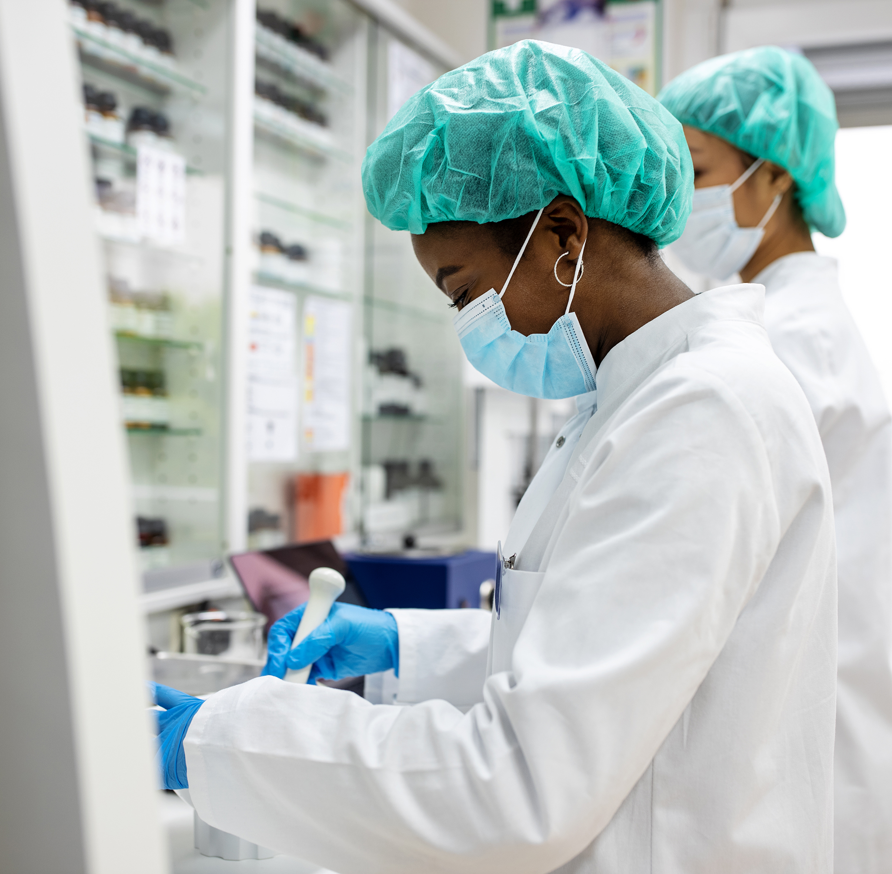
Izinjongo
Ukuze unikeze umbono wochwepheshe ekuthuthukisweni kwesu lomkhankaso wezifo ezithelelanayo we-Wellcome kanye nokusetshenziswa kwawo
Ukuze kuthuthukiswe ukubandakanywa kanye nokulingana endleleni yomkhankaso wezifo ezithelelanayo we-Wellcome
Ukuhlinzeka ngemibono yomhlaba wonke ukusiza ukuqinisekisa ukuthi umkhankaso ufanelekile futhi usebenza kahle kubantu abaqondiwe
Ukuhlola nokubekela inselele indlela ehlongozwayo ye-Wellcome kanye nemibono ngendlela eyakhayo

Slide 8
Ukuba ilunga
Sifuna amalunga angu-10 avela emhlabeni wonke anolwazi lokukhankasela ngempumelelo ukuzuza ushintsho ezifweni ezithelelanayo.
Sifuna ukuthola ikakhulu kazi laba abake basebenza eBrazil, eNingizimu Afrika, e-India, e-Indonesia noma e-US, njengoba lawa kuzoba amazwe abalulekile esizogxila kuwo ukwakha nokuletha umkhankaso wethu.
Sikhuthaza izicelo ezivela kubantu akhubazekile, i-neurodivergent, LGBTQIA+, abanolwazi lokunakekela, abangenasimo, nanoma yimuphi umphakathi ngokuvamile ongamelelwa kahle

Slide 9
Ukufinyeleleka
Siyazi ukuthi kungenzeka singazilungisi izinto, kodwa sikholelwa ukuthi ukufinyeleleka kuyisidingo, hhayi ukunethezeka. Sizoziphendulela futhi siqinisekise ukuthi:
Sizohlinzeka ngomhumushi uma ukhetha ukuxhumana ngolimi okungelona isiNgisi.
Sizovumela amagama-ncazo azenzakalelayo ngamaQembu e-Microsoft, inkundla yezingcingo zevidiyo esiyisebenzisayo.
Amaseshini ngeke aqoshwe ukuze sibe nendawo ephephile ndawonye.
Sizolandela imihlahlandlela yemihlangano efaka wonke umuntu, ithimba lethu e-Wellcome eliyihlolayo ukuze lenze imihlangano ihlanganise wonke umuntu.
Uma unezinye izidingo zokuxhumana noma imibuzo, sicela usithumele i-imeyili ku-idcampaign@wellcome.org. futhi sizokwenza konke okusemandleni ukuze sikusekele.

Slide 10
Ungayisekela kanjani imikhankaso ye-Wellcome?
Sifuna ukusebenzisana nawe ukuze silethe imikhankaso enomthelela, elinganayo futhi eqanjwe kabusha emazweni ethu esiwahlosile, ngenxa yolwazi lwakho.
Impendulo kanye nezincomo zeQembu Lokweluleka zizosetshenziswa yithimba le-Wellcome Campaigns ekuthatheni kwalo izinqumo mayelana nomkhankaso wezifo ezithelelanayo.
Ulwazi lwakho nesipiliyoni sakho kuzoqinisekisa ukuthi imikhankaso yethu isebenza ngaphezu komongo wase-UK.
Ngokusebenzisana neQembu Lokweluleka Lomkhankaso, umbono wakho oyingqayizivele uzoqinisekisa ukuthi indlela yethu yomkhankaso iyasebenza futhi iyalingana emhlabeni jikelele.

Slide 11
Esikudingayo kuwe
I-Wellcome ibheke ukwenza imikhankaso yesikhathi eside (iminyaka engu-3-5+) njengoba sibhekana nezindaba zesikhathi eside nezihlelekile, kodwa siyaqonda ukuthi amalungu angase angakwazi ukuzinikela unomphela.
Sifuna amalungu azokwazi ukuzibophezela okungenani unyaka owodwa kusukela kuNcwaba 2023 eqenjini.
Okubalulekile okuzolethwa kuzoba yimpendulo ekuqhubekeleni phambili komkhankaso wezifo ezithelelanayo. Lokhu kuzobandakanya usuku olulodwa lomsebenzi ngenyanga okuhlanganisa:
Ukuhambela umhlangano wanyanga zonke nethimba le-Wellcome othatha amahora angu-1-2
Isikhathi sokubuyekeza amadokhumenti/izimpahla nokuthumela izimpendulo ezibhaliwe.
Ithimba elithi Welcome lizohlinzeka ngezinto okufanele zibuyekezwe ngaphambi kokungena kwanyanga zonke.

Slide 12
ububanzi bomsebenzi
Kuzothintwa amalungu futhi acelwe impendulo mayelana nokuthuthukiswa komkhankaso wezifo ezithathelwanayo, okuhlanganisa kodwa kungagcini nje kule misebenzi elandelayo:
Singakuthuthukisa kanjani ukulingana, ukuhlukahluka kanye nokufakwa emkhankasweni wethu wezifo ezithelelanayo
Indlela engcono kakhulu yokuhlanganisa nokweseka imiphakathi ehlaselwe kakhulu izifo ezithelelanayo
Ukuqapha nokuhlola ukuqaliswa komkhankaso
Kufanele sikuhumushe kanjani ukuqonda kwezilaleli ukuze silolonge umkhankaso
Singayithonya kanjani inqubomgomo ye-R&D yezifo ezithelelanayo ngomkhankaso
Singakukhulisa kanjani ukuqonda komqondo wokukhuphuka
Impendulo nokuhlaziya ngemisebenzi yomkhankaso nomthelela wawo
Izeluleko ngamanuances ezindawo kanye nezidingo ezihlanganisa ozakwethu abafanelekile ongasebenza nabo, izithiyo ezingaba khona zokufeza izinjongo emazweni okuhlosiwe kanye nokucatshangelwa kwamasiko/okwenhlalo/umnotho ukuze kusetshenziswe amaqhinga omkhankaso.

Slide 13
Okungaphadle kohlelo
Okulandelayo akusebenzi eqenjini elisebenzayo:
Izindawo eziyisihloko sezifo ezithelelanayo ezingahlonzwanga isu le-Wellcome isb. izifo ezinganakiwe zasezindaweni ezishisayo noma i-WASH
Isu elibanzi lephothifoliyo yezifo ezithelelanayo, elibekwe ithimba Lezinhlelo Zokucwaninga e-Wellcome
ukuphakamisa izindawo ezintsha
Amaqhinga angqubuzana nesimo se-Wellcome esisemthethweni noma sokupha

Slide 14
Okunikelwa yi-Wellcome
Ukuba yingxenye yeqembu lethu labeluleki kuzokunikeza ithuba loku:
Faka isandla ekuguqukeni kwesistimu kwezempilo yomhlaba wonke, njengoba umkhankaso we-Wellcome uzothonya abenzi bezinqubomgomo zomhlaba wonke kanye nezimboni ukubhekana nezifo ezithelelanayo kusenesikhathi, ngempumelelo nangokulinganayo.
Nweba inethiwekhi yakho futhi wakhe ukuxhumana nabakhankasi abanolwazi abangamalungu eqembu labaluleki
Thola okwenzeka ngemuva kwa-Wellcome ukuze ubone ukuthi umxhasi womhlaba wonke usebenza kanjani futhi ube nomthelela emsebenzini wethimba lemikhankaso
Futhi sihlinzeka ngo-£700 ngosuku (amahora angu-7) kulo msebenzi.

Slide 15
Yini ongayilindela ku-Wellcome
Ukuze ube nethuba lokubumba indlela iqembu elisebenza ngayo. Omunye wemisebenzi yethu yokuqala njengeqembu kuzoba ukuvumelana ngezindlela zokusebenza ezihlanganisa indlela yokuthumela nokuthola imibono, izikhathi zemihlangano, ukuhanjiswa kwezimpendulo kanye neshathi yezenhlalo yokuxhumana.
Ukulalelwa kanye nokucutshungulwa kwemibono yakho. Uma kwenzeka noma imiphi imibono ingadluliselwa phambili, sizohlinzeka ngencazelo egcwele necacile yokuthi kungani.
Ukuze ube namathuba avamile okunikeza impendulo. Sizoba namathuba njalo ngekota okuthi unikeze impendulo ebhaliwe neyomlomo ngezindlela zethu zokusebenza.
Ubulunga beqembu buzobandakanyeka futhi bufinyeleleke. I-Wellcome izothatha zonke izinyathelo eziphusile zokuqinisekisa ukuthi wonke amalungu eqembu angakwazi ukuba khona futhi abambe iqhaza ngokulinganayo.
Ukuxhumana okuvulekile nokwethembekile ngesikhathi esifanele, okuhlanganisa okungenani izinsuku eziyi-7 zokubuyekeza imibhalo ngaphambi kwemihlangano.

Slide 16
Izinyathelo ezilandelayo

Slide 17
Isikhathi esibekiwe
14 kuMbasa – izicelo ziyavulwa
12 kuNhlaba – umnqamulajuqu wezicelo
12 kuNhlangulana– abazophumelela bazomenywa kwinhlolokhono
14 kuNhlangulana - 7 kuNtulikazi – ukuqhutshwa kwenhlolokhona
12 kuNtulikazi – abazophumelela bazokwaziswa
13 - 31 kuNtulikazi – ukwenza isivumelwano
31 kuNtulikazi - 25 kuNcwaba – umhlangano wokuqala wokungeniswa osungulwe ne-Wellcome
kuNcwaba 2023 - kuNcwaba 2024 – imihlangano evamile

Slide 18
Izicelo
Sicela usazise uma unezidingo zokufinyelela. Sizokwenza konke okusemandleni ethu ukukusekela. Sicela usithinte ku-idcampaign@wellcome.org.
Sicela uthumele isicelo sakho ku-idcampaign@wellcome.org. futhi ufake:
Isifinyezo solwazi lwakho olufanele - lena kungaba yi-CV uma unayo, kodwa sizokwamukela nama-CV evidiyo, alalelwayo noma amaphothifoliyo.
Sicela usitshele ukuthi kungani ufuna ukujoyina iqembu labaluleki bomkhankaso wezifo ezithathelwanayo (ubuningi bamagama angu-300, noma imizuzu emi-2 uma ukhetha ukuthumela ngomsindo/ividiyo).
Sicela uzizwe ukhululekile ukuthumela isicelo sakho ngolimi oluncamelayo. Izisebenzi ze-Wellcome zikhuluma isiNgisi, kodwa singahumusha uhlelo lwakho lokusebenza.

Slide 19
izinhlolokhono
Uma isicelo sakho siphumelele, sizokuthinta ukuze simise inhlolokhono engahlelekile yemizuzu engama-30 no-Layla Deverson (Umphathi Womkhankaso) kanye nomunye uzakwethu we-Wellcome. Kuzoba ucingo lwevidiyo ebonakalayo, ehlelwa ngesikhathi esivumelana nawe. Uma unezidingo zokufinyelela, sizokwenza konke okusemandleni ethu ukukusekela.
Sizobuza:
Sitshele ngesikhathi ukhankasele ukuzuza ushintsho.
Kungani kubalulekile kuwe ukuthi wenze impilo yomhlaba wonke ibandakanyeke?
Uyobe usuthola ithuba lokusibuza imibuzo.

